Slide 1
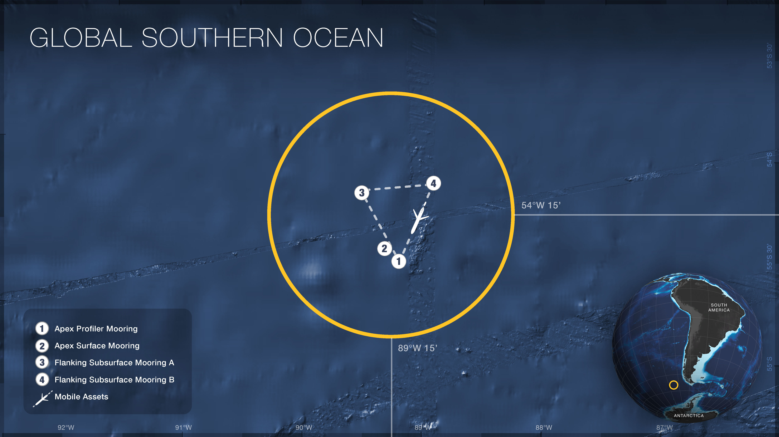
Jack McSweeney
May 26, 2018

Slide 2
Jack McSweeney
May 26, 2018
47 km

Slide 3
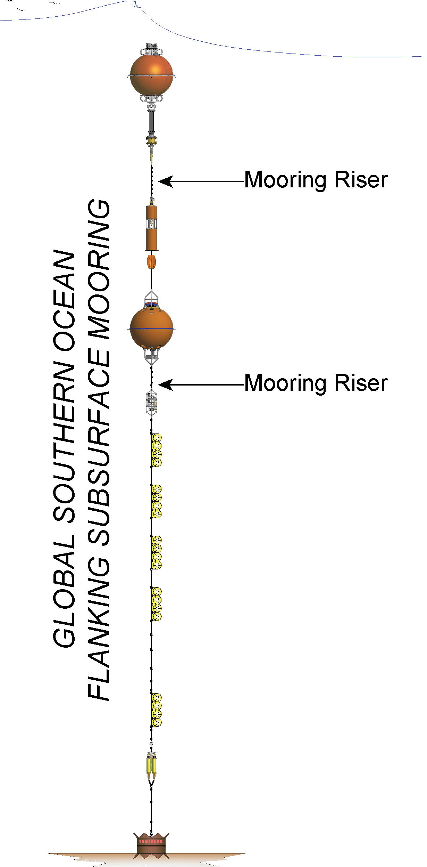
Science Goals
Describe the stratification variability
Spring-neap
Seasonal
Interannual
Link temporal variability to dynamics
Tides
Winds
Waves
Evaluate the spatial variability
2 moorings are 47 km apart
Link to processes

Slide 4
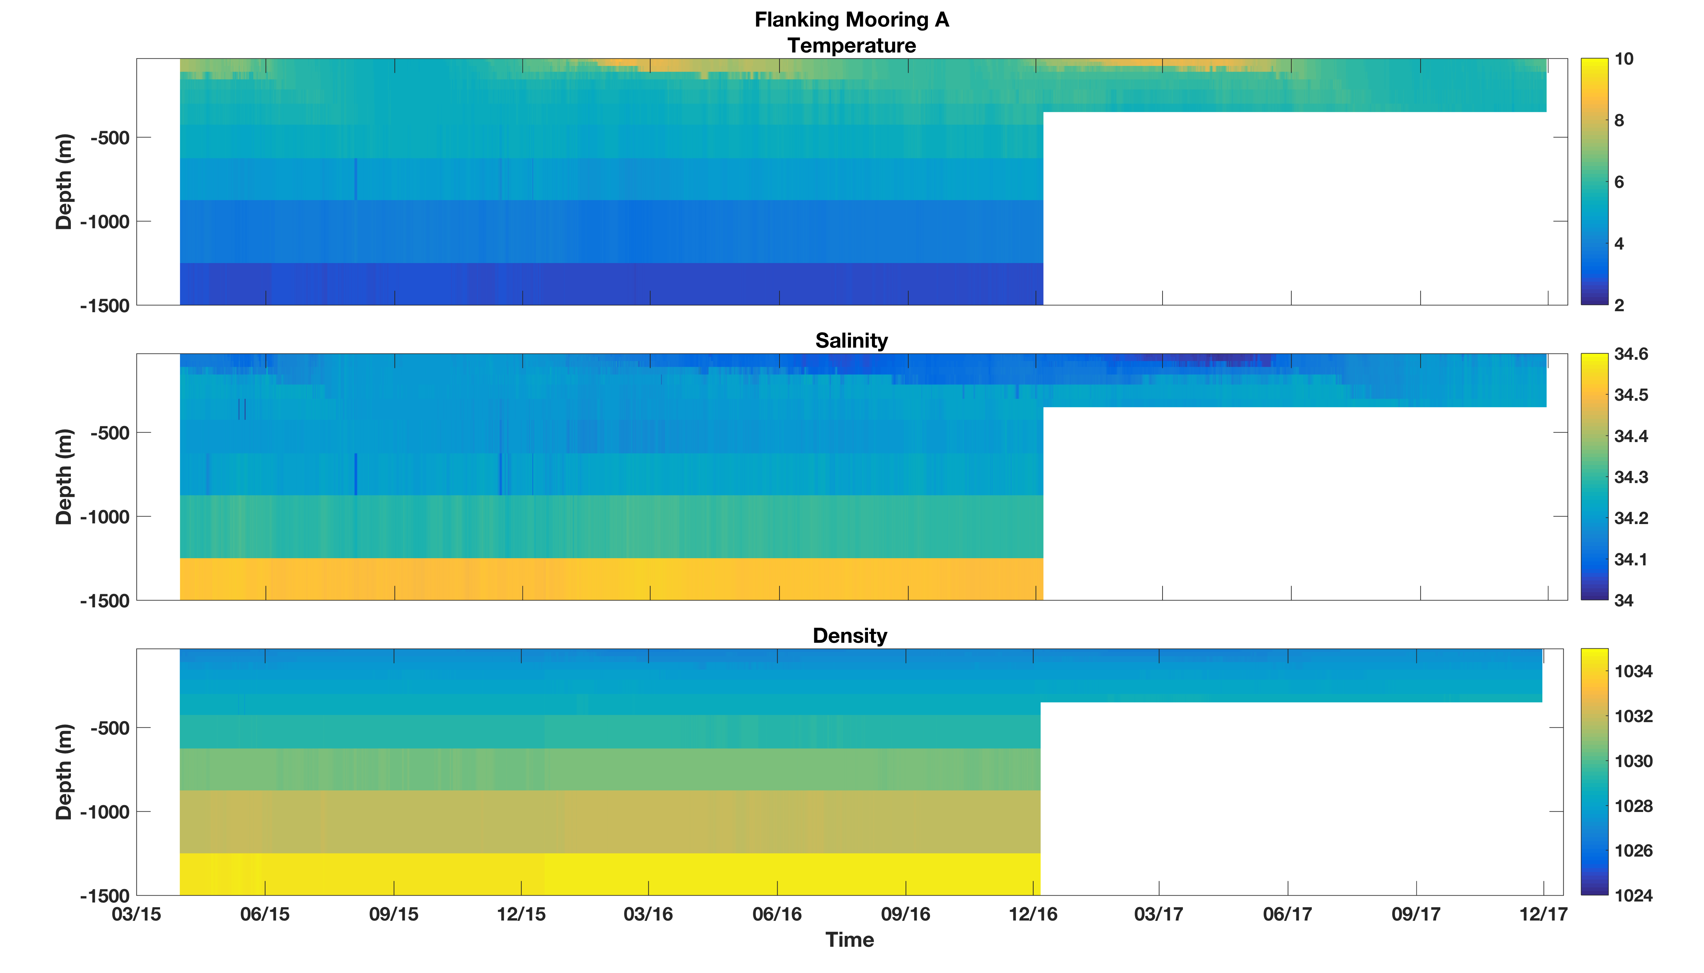

Slide 5


Slide 6
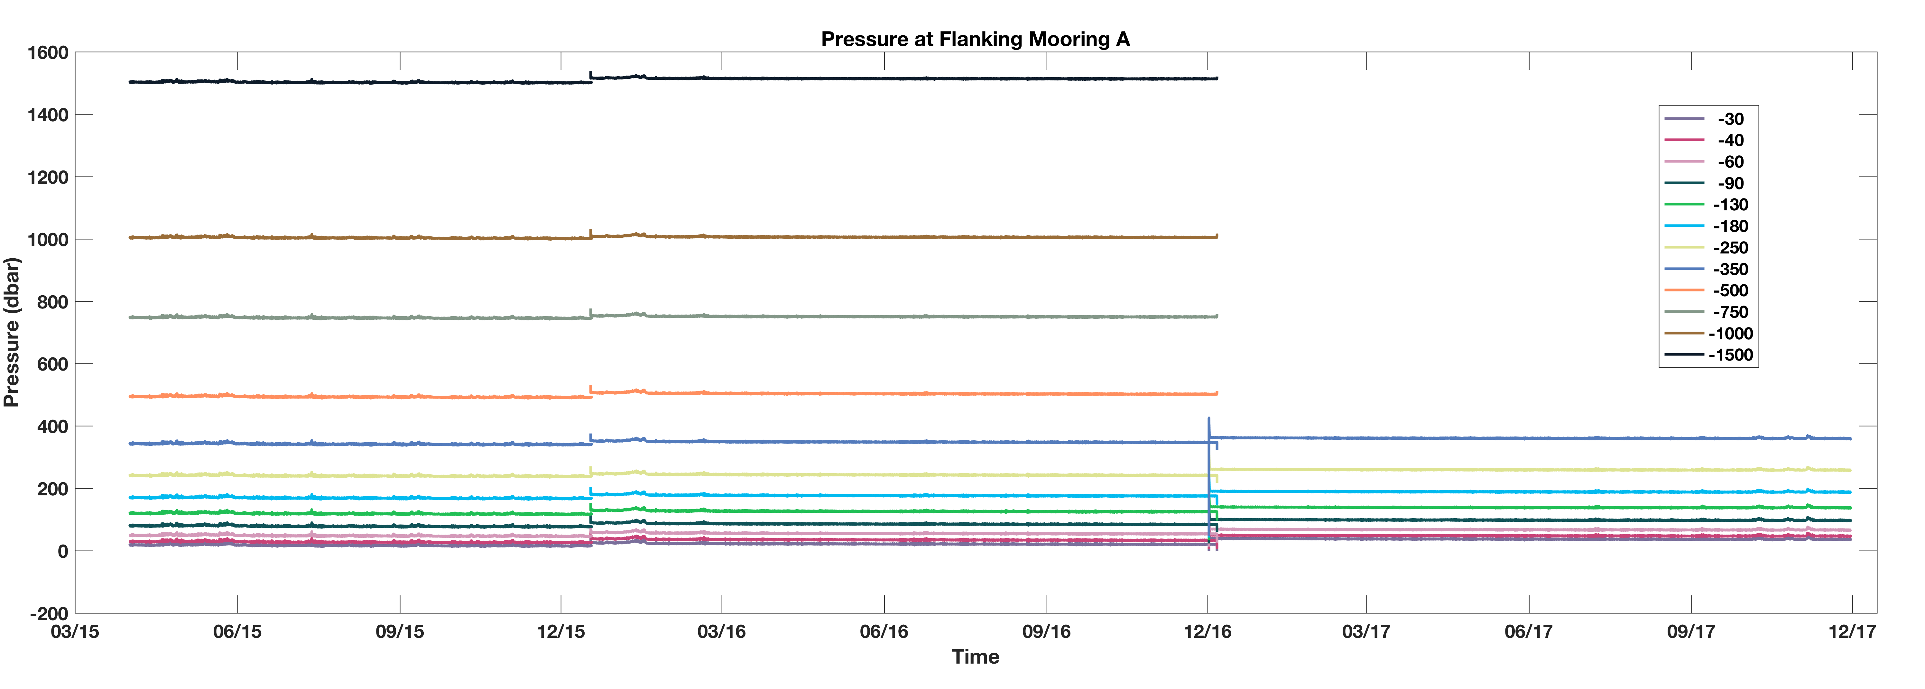

Slide 8
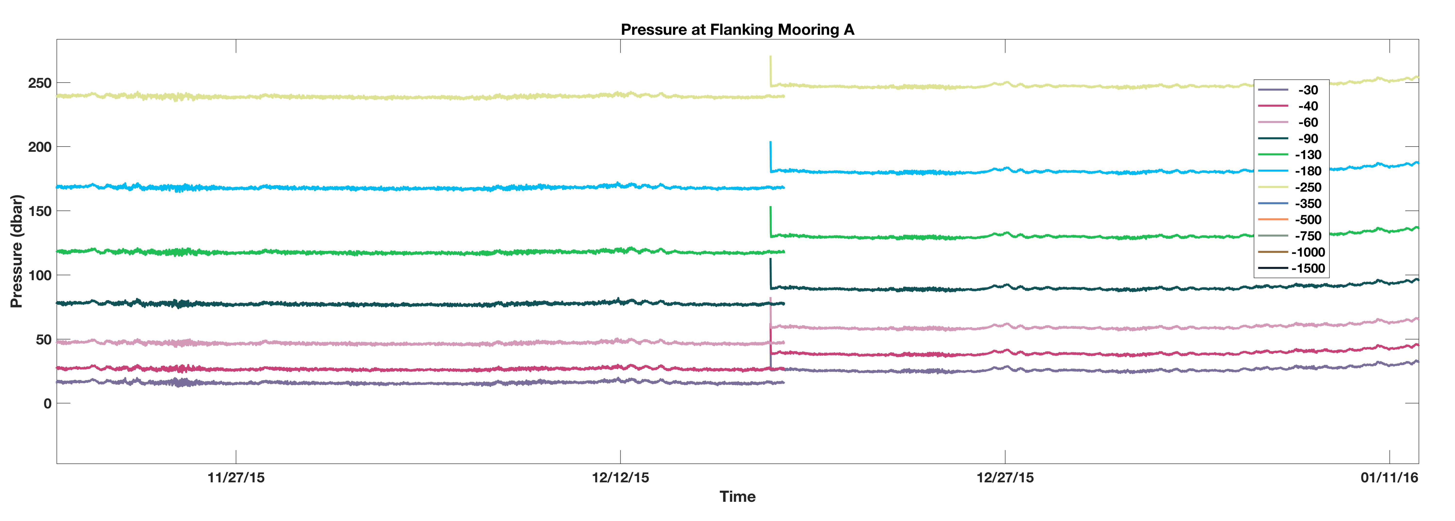

Slide 9
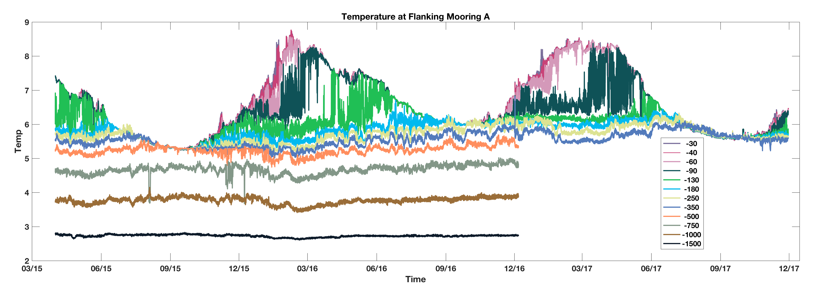

Slide 14
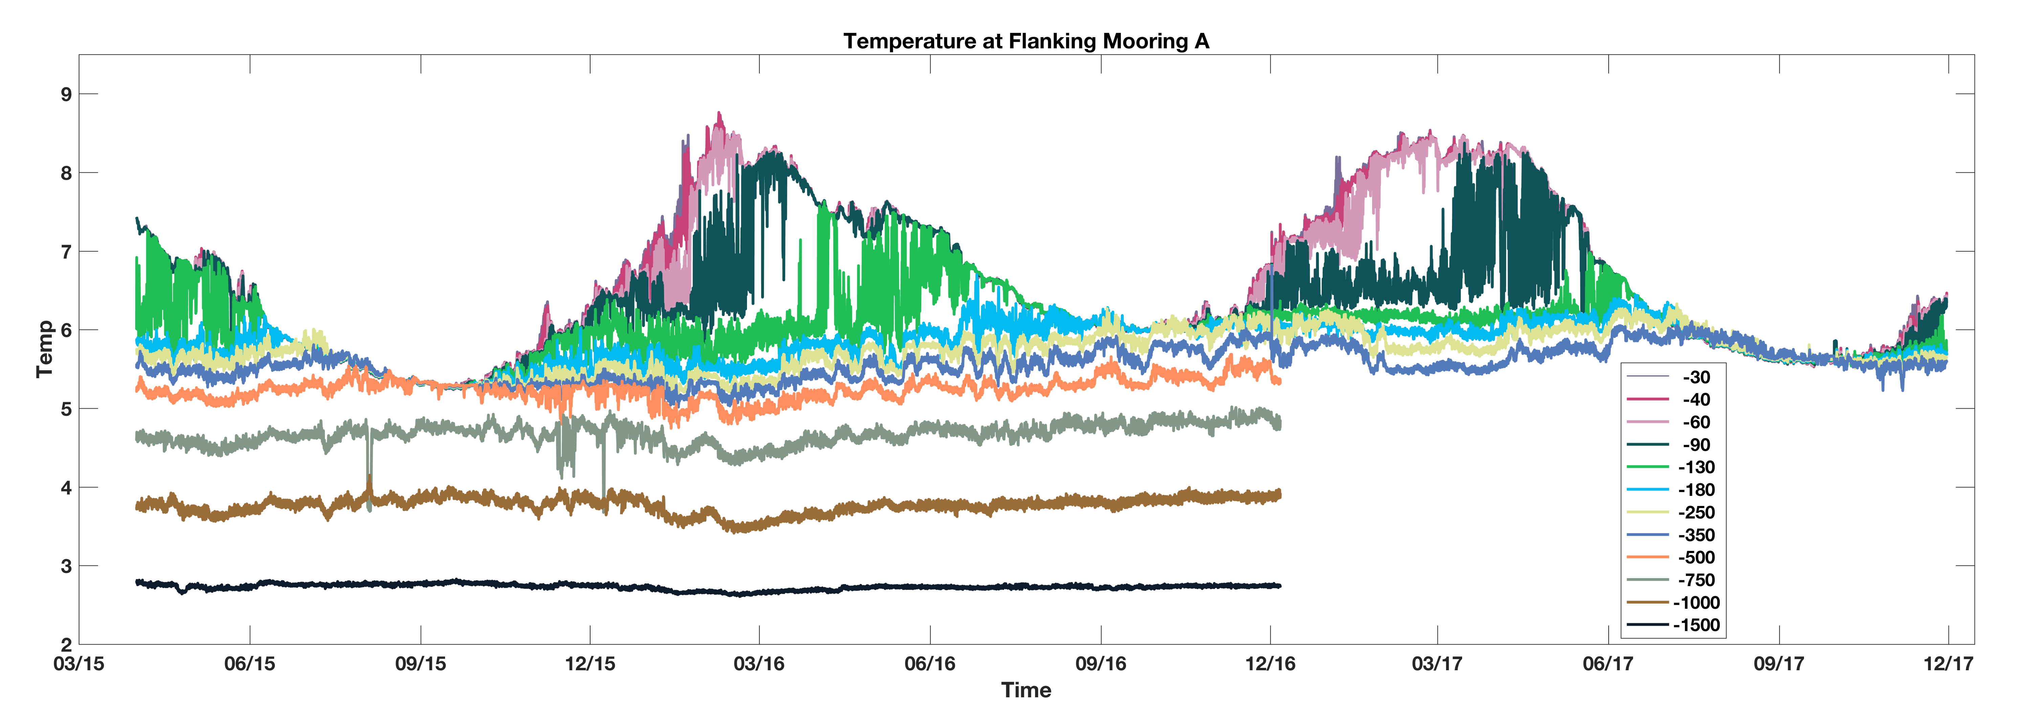
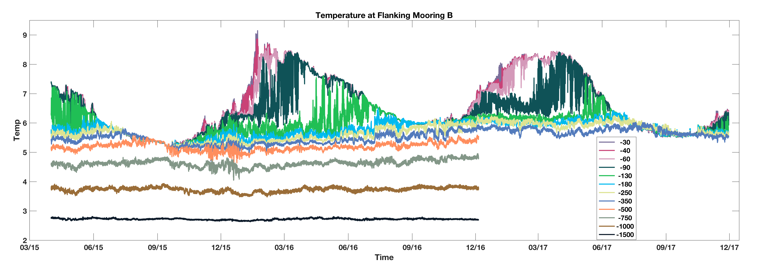

Slide 16
